Slide 1


Slide 2

Innovation

Slide 3
Novelty and Meaningfulness
Novelty
  Relatively new to the environment and to the users
Meaningfulness
  Whether it will be used by public on a large scale
  Do they need it? (wants/needs/irritations)

Slide 4
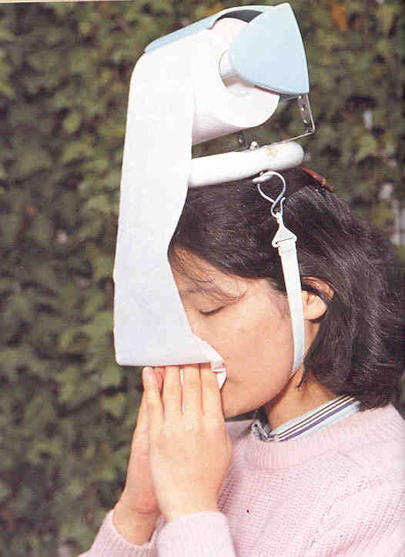
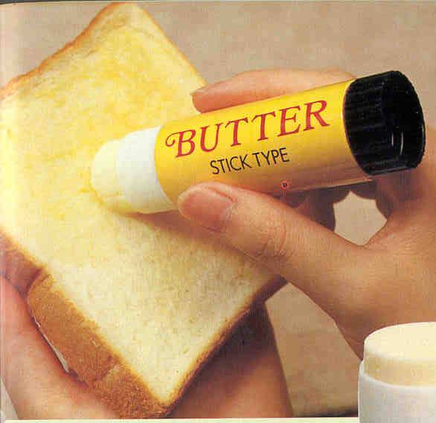
Novel? Meaningful?

Slide 5
Types of Innovation
Radical
Incremental
Flash of a genius
Radical shift
Rare and difficult
Builds upon existing knowledge
Small changes in current system
Common and easy
Notes:
Novelty needs thinking capability however radical innovation does not demand it.
Incremental innovation is possible if you know the system in detail while radical innovation does not need this.

Slide 6
Types of Innovation
Fridge (radical shift for society to preserver things) → new models with smaller increments every days, like with new cooling systems, better air flow algorithms etc
LED Bulbs (Radical Shift in luminosity) → Reducing energy consumption of LEDs (incremental)
GPS (Radical shift in navigational systems)→ Increasing accuracy with new algorithms (increments)
Notes:
Novelty needs thinking capability however radical innovation does not demand it.
Incremental innovation is possible if you know the system in detail while radical innovation does not need this.
Vespa to Bike
Piano pen to Picasso (irritations : cap was lost, ink was leaked, blobs formed while writing. usages of Picasso no need of cap, click releases stress, to fix elastic in trousers. )
How we used to preserve food before fridge? Clay pots and preservatives .

Slide 7
Some Innovations
Pocket cinema
  Projector of size of soda can
  Wireless speakers
Change of package color if food expires
Smart Glasses
  Find my glasses
  Turn to sun glasses
  Wireless charging
Notes:
Discuss whether they are meaningful or not ?

Slide 8
Innovation in different contexts
As an object/idea: an object which is novel and meaningful
As a process: the process with which we generate a novel and meaningful idea, which in turn is translated into a novel and meaningful product, which in turn creates value for the customer
Same word used for both, the object and the process

Slide 9
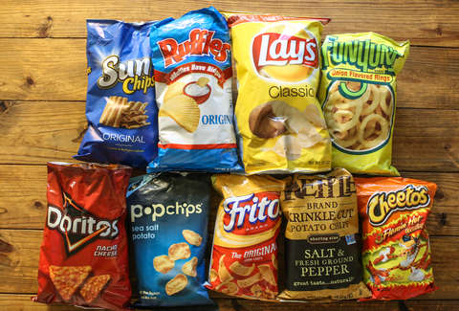
An Innovation?
Notes:
Is it innovative to have different brands of chips which are prepared in almost same manner ? (NO)
Package is not innovative
Content is innovative

Slide 10
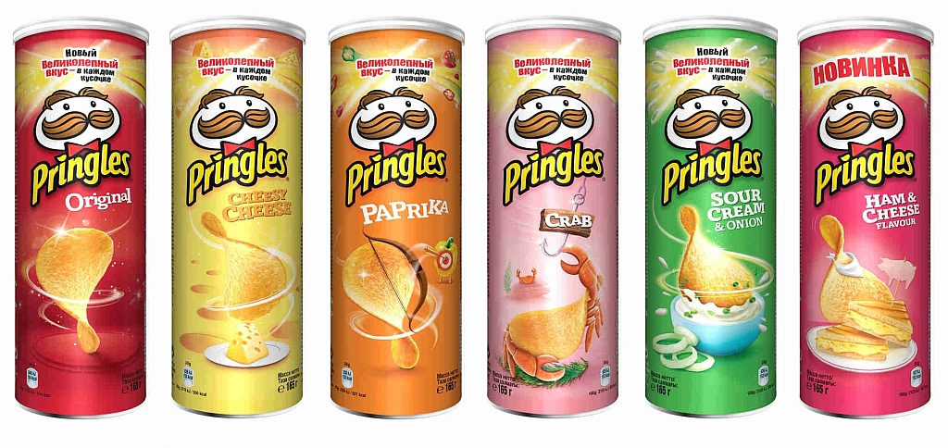
An Innovation?
Notes:
Are pringles prepared the same way as other chips? (NO)
This is innovative. It is prepared through a mixture of mashed potatoes which are then compressed in a heated environment. So, they are prepared differently and thus differ in taste.
even if their preparation is not innovative, their packaging is a very meaningful innovation

Slide 11
Incremental Innovation Example
Toyota is a great example of evolutionary innovation in practice.
They are not attempting to reinvent the car or create a product that will disrupt the entire car market.
Instead, Toyota focuses on building better cars for already existing markets.

Slide 12
Incremental Innovation Example
Introduction of Touch devices (radical Shift) followed by increments delivered almost everyday
Introduction of Laptops (radical Shift) followed by increments delivered almost everyday

Slide 13
Why innovate?
Why should we innovate?
  To explore, research and utilize all the know technologies to uncover something new.
  To start thinking out of the box.
  To solve problems easily.
  To increase our productivity.
  To have knowledge of changing market needs.
  To become creative not just a book worm..
  To beat your competitors .

Slide 14
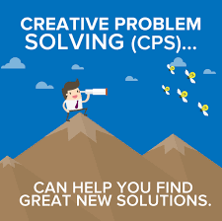
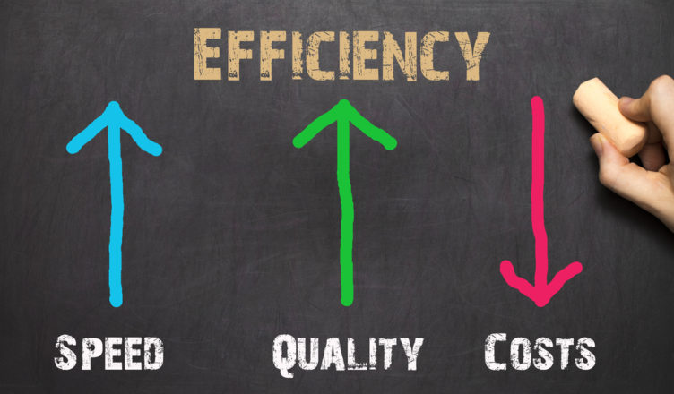


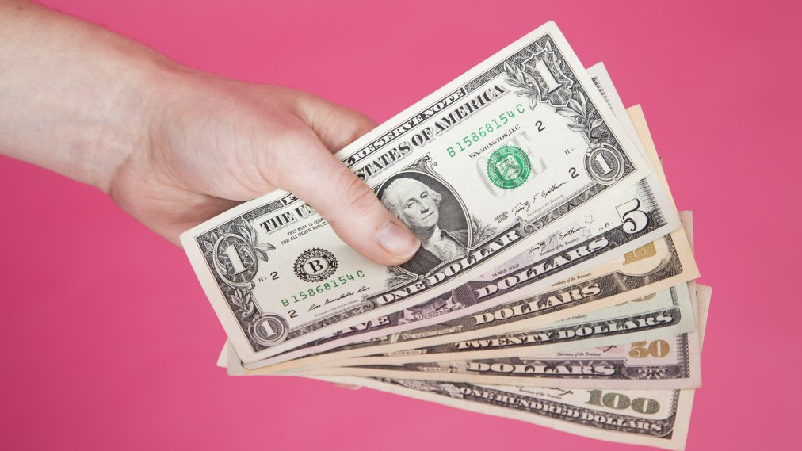

Why innovate?
What could be the outcome?

Slide 15
Inspiration
Wants
Needs
Irritations

Slide 16
Class Activity
Form your project group and sit accordingly.
4 members per group.

Slide 17
Class Activity to be conducted without any discussion.
Each member would come up with an existing problem. NOT SOLUTION
Write it down on paper.

